Slide 1



Noida Institute of Engineering and Technology, Greater Noida
Introduction to data structure, Arrays, Searching, Sorting and Hashing
Unit: 1
DATA STRUCTURES
Alisha Sikri
Assistant Professor
Computer Science and Engineering(AIML)
Course Details ( B Tech AIML - 3th Sem)

Slide 2
Course Outcome
CO 1 Describe the need of data structure and algorithms in problem solving and analyze Time space trade-off.
CO 2 Describe how arrays are represented in memory and how to use them for implementation of matrix operations, searching and sorting along with their computational efficiency.
CO 3 Design, implement and evaluate the real-world applications using stacks, queues and non-linear data structures.
CO 4 Compare and contrast the advantages and disadvantages of linked lists over arrays and implement operations on different types of linked list.
CO 5 Identify and develop the alternative implementations of data structures with respect to its performance to solve a real-world problem.

Slide 3
Syllabus
UNIT-1
Data types: Primitive and non-primitive, Types of Data Structures- Linear & Non-Linear Data Structures. Time and Space Complexity of an algorithm, Asymptotic notations (Big Oh, Big Theta and Big Omega), Abstract Data Types (ADT).
Arrays: Definition, Single and Multidimensional Arrays, Representation of Arrays: Row Major Order, and Column Major Order, Derivation of Index Formulae for 1-D,2-D,3-D and n-D Array Application of arrays, Sparse Matrices and their representations.
Searching: Linear search, Binary search. Sorting: Bubble sort, Insertion sort, Selection sort, Radix Sort, Merge sort, Quick sort.
Hashing: The symbol table, Hashing Functions, Collision-Resolution Techniques.

Slide 4
Syllabus
UNIT-2
Linked List Self-referential structure, Singly Linked List, Doubly Linked List, Circular Linked List.
Operations on a Linked List: Insertion, Deletion, Traversal, Reversal, Searching Polynomial Representation and Addition Subtraction & Multiplications of Polynomials.

Slide 5
Syllabus
UNIT-3
Stacks: Primitive Stack operations: Push & Pop, Array and Linked Implementation of Stack, Application of Stack: Infix, Prefix, Postfix Expressions and their Mutual Conversion, Evaluation of Postfix Expression.
Recursion: Principles of Recursion, Tail Recursion, Removal of Recursion, Problem Solving using Iteration and Recursion with examples such as Binary Search, Fibonacci Series, and Tower of Hanoi, Trade-offs between Iteration and Recursion.
Queues: Array and linked Implementation of Queues, Operations on Queue: Create, Insert, Delete, Full and Empty, Circular Queues, Dequeue and Priority Queue.

Slide 6
Syllabus
UNIT-4
Tree Basic terminology used with Tree, Binary Trees, Binary Tree Representation: Array Representation and Pointer (Linked List) Representation, Binary Search Tree, Strictly Binary Tree, Complete Binary Tree, An Extended Binary Trees.
Tree Traversal algorithms: In-order, Pre-order and Post-order, Constructing Binary Tree from given Tree Traversal, Operation of Insertion, Deletion, Searching & Modification of Data in Binary Search Tree, Binary Heaps, Heap Sort, Threaded Binary Trees, Traversing Threaded Binary trees, Huffman Coding using Binary Tree, Concept & Basic Operations for AVL Tree, B-Tree & Binary Heaps, Heap Sort.

Slide 7
Syllabus
UNIT-5
Graphs: Terminology used with Graph, Data Structure for Graph Representations: Adjacency matrices, Adjacency List.
Graph Traversal: Depth First Search and Breadth First Search. Connected Component, Spanning Trees, Minimum Cost Spanning Trees: Prim’ s and Kruskal’s algorithm. Transitive Closure and Shortest Path algorithms: Dijkstra Algorithm.
File Structure: Concepts of files, records and files, Sequential, Indexed and Random File Organization, Indexing structure for index files, hashing for direct files, Multi-Key file organization and Access Methods.

Slide 8
Contents
Primitive and non-primitive data types
Types of Data Structures- Linear & Non-Linear Data Structures
Asymptotic notations (Big Oh, Big Theta and Big Omega),
Abstract Data Types (ADT).
Arrays
Searching and Sorting
Hashing

Slide 9
Objective of Unit
Objective of the course is to make students able to:
Learn the basic types for data structure, implementation and application.
Know the strength and weakness of different data structures.
Use the appropriate data structure in context of solution of given problem.
4. Develop programming skills which require to solve given problem.

Slide 10
Course Outcome
CO1:
Describe the need of data structure and algorithms in problem solving and analyze Time space trade-off.

Slide 11
Topic mapping with Course Outcome
Topic mapping with Course Outcome
Topic | CO1 | CO2 | CO3 | CO4 | CO5
Basic Data Structure | 3 | - | - | - | -
Array | 2 | - | - | - | -

Slide 12
Prerequisite and Recap
Data types
Variables
Operators
Input/ output
Conditional and Control statements
Arrays
Strings

Slide 13
Basic Terminologies
Introduction (CO1)
Data: are simply a value are set of values of different type which is called data types like string, integer, char etc.
Structure: Way of organizing information, so that it is easier to use.
In simple words we can define DATA STRUCTURES as its a way organizing data in such a way so that data can be easier to use.

Slide 14
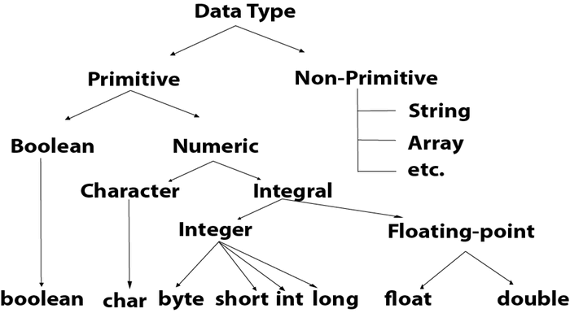
Data Types (CO1)
Data Type:-

Slide 15
Data Structure (CO1)
Data Structure
Data structure is a storage that is used to store and organize data. It is a way of arranging data on a computer so that it can be accessed and updated efficiently.

Slide 16
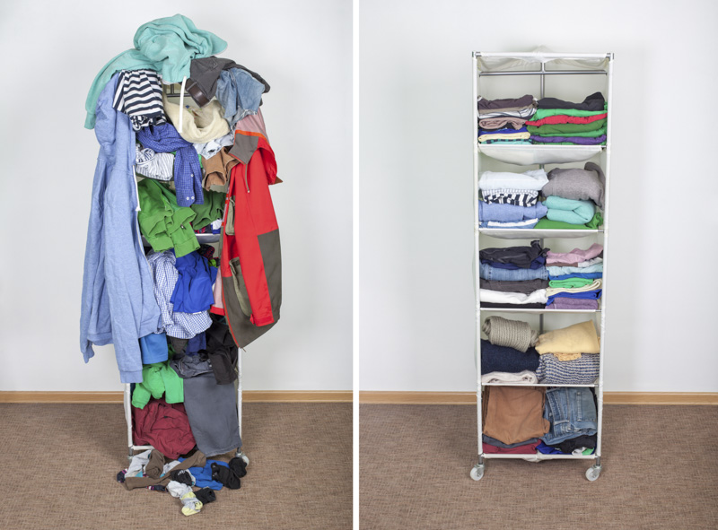
Why Data Structure
Data Structure (CO1)

Slide 17
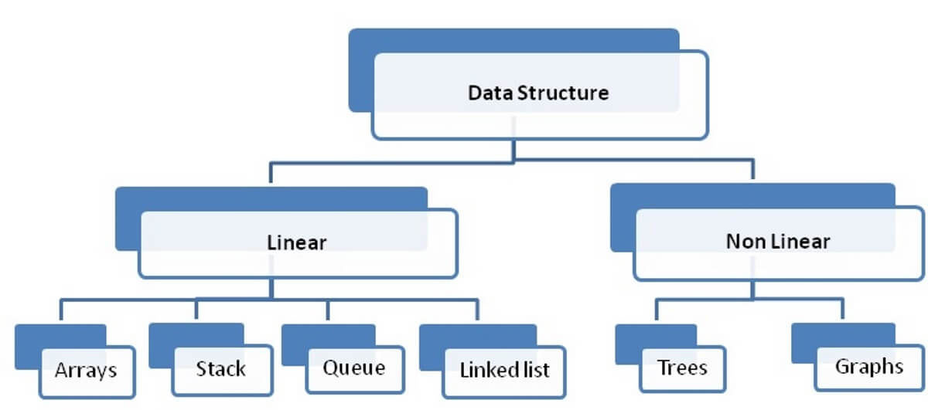
Types of Data Structure
Data Structure (CO1)

Slide 18
Data Structure is classified into two categories : Linear Data Structure Non Linear Data Structure
Data Structure (CO1)

Slide 19
Classification of Data Structure ...
Introduction (CO1)
Linear Data Structure: Data structure where data elements are arranged sequentially or linearly where the elements are attached to its previous and next adjacent in what is called a linear data structure. Examples are:- array, stack, queue, linked list, etc.
Non-linear Data Structure: Data structures where data elements are not arranged sequentially or linearly are called non-linear data structures.

Slide 20
Difference between Linear and Non-linear Data Structures:
Data Structure (CO1)
Linear Data Structure | Non-Linear Data Structure
Every item is related to its previous and next item. | Every item is attached with many other items.
Data is arranged in linear sequence. | Data is not arranged in sequence.
Data items can be traversed in a single run. | Data can not be traversed in a single run.
Examples: Array, Stack, Queue, Linked List. | Examples: Tree, Graph.
Implementation is Easy. | Implementation is Difficult.

Slide 21
Operation on Linear/Non-Linear Data Structure
Data Structure (CO1)
Add an element
Delete an element
Traverse / Display
Sort the list of elements
Search for a data element

Slide 22
Types of Linear Data Structure
Data Structure (CO1)
Array : An array is the collection of the variables of the same data type that are referenced by the common name.
A stack is a LIFO (Last In First Out) data structure where element that added last will be deleted first. All operations on stack are performed from on end called TOP. A TOP is a pointer which points to the top element- the element which entered last in the stack.
A queue is a FIFO (First In First Out) data structure where element that added first will be deleted first. In queue, insertion is performed from one end called REAR and deletion is performed from another end called FRONT.
A linked list is a collection of nodes, where each node is made up of a data element and a reference to the next node in the sequence.

Slide 23
Types of NON Linear Data Structure
Introduction (CO1)
A tree is collection of nodes where these nodes are arranged hierarchically and form a parent child relationships. A tree is recursively defined as a set of one or more nodes where one node is designated as the root of the tree and all the remaining nodes can be partitioned into non empty sets each of which is a sub tree of the root.
A Graph is a collection of a finite number of vertices and an edges that connect these vertices. Edges represent relationships among vertices that stores data elements.

Slide 24
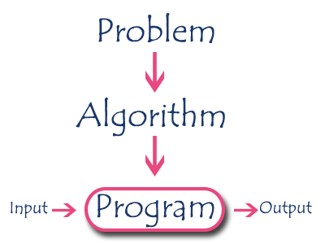
Introduction to Algorithms(CO1)
Algorithm is a step-by-step procedure, which defines a set of instructions to be executed in a certain order to get the desired output.
Algorithms are generally created independent of underlying languages, i.e. an algorithm can be implemented in more than one programming language.

Slide 25
Performance analysis of an algorithm
Introduction to Algorithms(CO1)
Space required to complete the task of that algorithm (Space Complexity).
Time required to complete the task of that algorithm (Time Complexity).

Slide 26
Space Complexity
Introduction to Algorithms(CO1)
When we design an algorithm to solve a problem, it needs some computer memory to complete its execution. For any algorithm, memory is required for the following purposes...
To store program instructions.
To store constant values.
To store variable values.
And for few other things like function calls, jumping statements etc,.
Total amount of computer memory required by an algorithm to complete its execution is called as space complexity of that algorithm

Slide 27
Time Complexity
Introduction to Algorithms(CO1)
Every algorithm requires some amount of computer time to execute its instruction to perform the task. This computer time required is called time complexity. The time complexity of an algorithm can be defined as follows...
The time complexity of an algorithm is the total amount of time required by an algorithm to complete its execution.

Slide 28
Introduction to Algorithms(CO1)
Example 1
int sum(int a, int b)
{
c = a+b;
return c;
}
Space Complexity –
In the above piece of code, it requires 2 bytes of memory to store variable 'a' and another 2 bytes of memory is used for return value.
That means, totally it requires 4 bytes of memory to complete its execution. And this 4 bytes of memory is fixed for any input value of 'a'. This space complexity is said to be Constant Space Complexity.
Time Complexity –
It requires 1 unit of time to calculate a+b and 1 unit of time to return the value. That means, totally it takes 2 units of time to complete its execution
If any program requires a fixed amount of time for all input values then its time complexity is said to be Constant Time Complexity.

Slide 29
Introduction to Algorithms(CO1)
Example 2
int sum(int A[ ], int n)
{
int sum = 0, i;
for(i = 0; i < n; i++)
sum = sum + A[i];
return sum;
}
In the above piece of code it requires
'n*2' bytes of memory to store array variable 'a[ ]'
2 bytes of memory for integer parameter 'n'
4 bytes of memory for local integer variables 'sum' and 'i' (2 bytes each)
2 bytes of memory for return value.
That means, totally it requires '2n+8' bytes of memory to complete its execution. Here, the total amount of memory required depends on the value of 'n'. As 'n' value increases the space required also increases proportionately. This type of space complexity is said to be Linear Space Complexity.

Slide 30
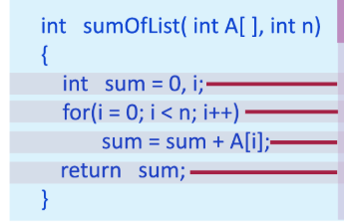
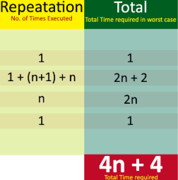
Introduction to Algorithms(CO1)
If the amount of time required by an algorithm is increased with the increase of input value then that time complexity is said to be Linear Time Complexity.

Slide 31
Asymptotic Notations (CO1)
The asymptotic running time of an algorithm are defined in terms of functions whose domains are the set of natural numbers. The following are the types of asymptotic notation
Big Theta Notation
Big Oh Notation
Big Omega Notation
Small Oh Notation
Small Omega Notation

Slide 32
Purpose of Asymptotic Notations
Asymptotic Notations (CO1)
To simplify the running time of the function
To describe the behavior of the function.
To provide asymptotic bound.
To describe how the running time of an algorithm increases with increase in input size

Slide 33
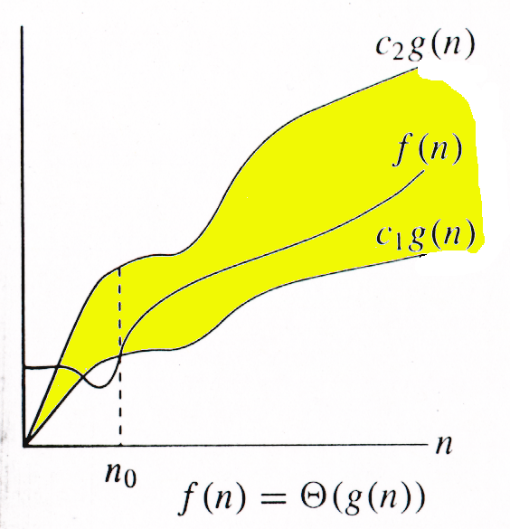
Big Theta Notation
The function f(n) = Θ(g(n)) (read as “ f of n is theta of g of n”) if there exist positive constants c1 and c2 and n0 such that
c1g(n)≤f(n)≤c2g(n) for all n≥ n0

Slide 34
Big Theta Notation
Example
Let us consider a given function,
f(n)=4.n³+10.n²+5.n+1
Considering g(n)=n³,
4.g(n)⩽f(n)⩽5.g(n) for all the large values of n.
Hence, the complexity of f(n) can be represented as
θ(g(n)), i.e. θ(n³)

Slide 35
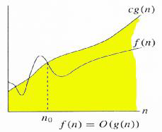
Big Oh Notation
The function f(n) = O(g(n)) (read as “ f of n is big oh of g of n”) if there exist positive constants c and n0 such that
f(n)≤cg(n) for all n≥ n0

Slide 36
Big Oh Notation
Example
Let us consider a given function,
f(n)=4.n³+10.n²+5.n+1
Considering g(n)=n³,
f(n)⩽5.g(n) for all the values of n>2.
Hence, the complexity of f(n) can be represented as
O(g(n)), i.e. O(n³)

Slide 37
Big Oh Notation
Q1 f(n) = 3n + 4, g(n) = n, Prove f(n) = O(g(n))
Sol.
To prove f(n) = O(g(n)) i.e. f(n) <= c.g(n)
It means 3n + 4 <=c.n
Let c= 5
n | f(n) |  | c. g(n)
 | 3n+4 |  | 5n
1 | 7 | > | 5
2 | 10 | = | 10
3 | 13 | < | 15
4 | 16 | < | 20
So, for n₀ = 2
f(n) < = 5.g(n)
Hence f(n) = O(g(n))

Slide 38
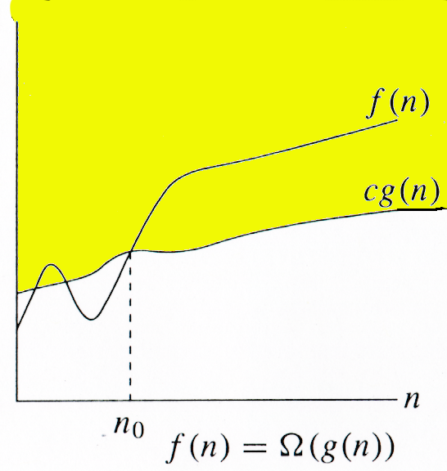
Big Omega Notation
The function f(n) = Ω(g(n)) (read as “ f of n is Ω of g of n”) if there exist positive constants c and n0 such that
cg(n)≤ f(n) for all n≥ n0

Slide 39
Big Omega Notation
Example
Let us consider a given function,
f(n)=4.n³+10.n²+5.n+1
Considering g(n)=n³,
f(n) ≥ 4.g(n) for all the values of n>0.
Hence, the complexity of f(n) can be represented as
Ω (g(n)), i.e. Ω(n³)

Slide 40
Small Oh Notation
Upper bound that is not asymptotically tight
f(n) = o(g(n)) if f(n)< c(g(n)) for all n≥ n0
f(n) becomes insignificant relative to g(n) as n approaches infinity:
lim [f(n) / g(n)] = 0
^{n→∞}
g(n) is an upper bound for f(n) that is not asymptotically tight.

Slide 41
Small Oh Notation
Example
Let us consider a given function,
f(n)=4.n³+10.n²+5.n+1
Considering g(n)=n⁴,
lim (4.n³+10.n²+5.n+1/ n⁴ )=0
n→∞
Hence, the complexity of f(n) can be represented as
o(g(n)), i.e. o(n⁴)

Slide 42
Small Omega Notation
lower bound that is not asymptotically tight
f(n) = ω(g(n)) if c(g(n))< f(n) for all n≥ n0
f(n) becomes arbitrarily large relative to g(n) as n approaches infinity:
lim [f(n) / g(n)] = ∞.
^{n→∞}
g(n) is a lower bound for f(n) that is not asymptotically tight.

Slide 43
Small Omega Notation
Example
Let us consider a given function,
f(n)=4.n³+10.n²+5.n+1
Considering g(n)=n²,
lim (4.n³+10.n²+5.n+1/ n² )=0
n→∞
Hence, the complexity of f(n) can be represented as
ω (g(n)), i.e. ω(n⁴)

Slide 44
Abstract Data Types
Abstract Data type (ADT) is a type (or class) for objects whose behavior is defined by a set of value and a set of operations.
The definition of ADT only mentions what operations are to be performed but not how these operations will be implemented.
It does not specify how data will be organized in memory and what algorithms will be used for implementing the operations.
It is called “abstract” because it gives an implementation-independent view. The process of providing only the essentials and hiding the details is known as abstraction.

Slide 45
Abstract Data Types
An ADT is a mathematical model of a data structure that specifies the type of data stored, the operations supported on them, and the types of parameters of the operations. An ADT specifies what each operation does, but not how it does it. Typically, an ADT can be implemented using one of many different data structures. A useful first step in deciding what data structure to use in a program is to specify an ADT for the program.

Slide 46
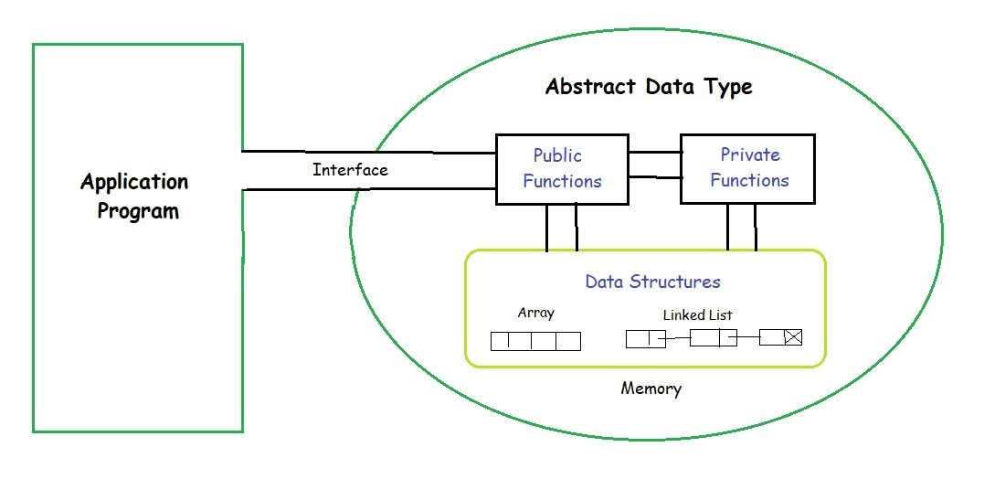
Abstract Data Types

Slide 47
Abstract Data Types
In general, the steps of building ADT to data structures are:
Understand and clarify the nature of the target information unit.
Identify and determine which data objects and operations to include in the models.
Express this property somewhat formally so that it can be understood and communicate well.
Translate this formal specification into proper language Upon finalized specification, write necessary implementation. This includes storage scheme and operational detail. Operational detail is expressed as separate functions (methods).

Slide 48
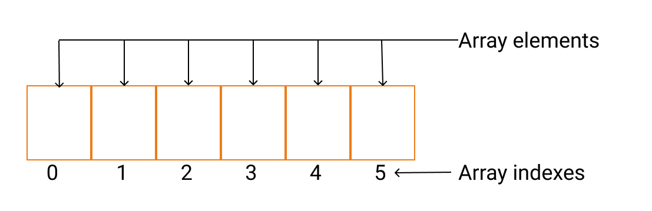
Array
Introduction to Array (CO1)
Array is defined as the collection of similar type of data items stored at contiguous memory locations.
Array is the simplest data structure where each data element can be randomly accessed by using its index number.

Slide 49
Array
Introduction to Array (CO1)
Array Index: The location of an element in an array has an index, which identifies the element. Array index starts from 0.
Array element: Items stored in an array is called an element. The elements can be accessed via its index.
Array Length: The length of an array is defined based on the number of elements an array can store. In the above example, array length is 6 which means that it can store 6 elements.

Slide 50
Need for an Array
Introduction to Array (CO1)
Arrays are best for storing multiple values in a single variable.
Arrays are better at processing many values easily and quickly.
Sorting and searching the values is easier in arrays.

Slide 51
Introduction to Array (CO1)
There is some specific operation that can be performed or those that are supported by the array. These are:
Traversing: It prints all the array elements one after another.
Inserting: It adds an element at given index.
Deleting: It is used to delete an element at given index.
Searching: It searches for an element(s) using given index or by value.
Updating: It is used to update an element at given index.

Slide 52
Introduction to Array (CO1)
Types of Array:- The various types of arrays are as follows.
One dimensional array or Linear Array
Multi-dimensional array

Slide 53
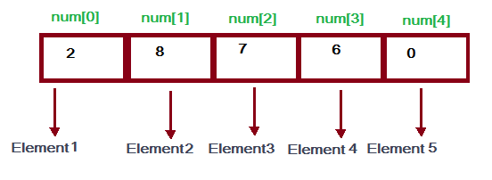
Introduction to Array (CO1)
One dimensional (1-D) arrays or Linear arrays: In it each element is represented by a single subscript. The elements are stored in consecutive memory locations. E.g. A [0], A [1], ….., A [N-1].

Slide 54
Introduction to Array (CO1)
Calculating the address Of any element In the 1-D array:
A 1-dimensional array (or single dimension array) is a type of linear array. Accessing its elements involves a single subscript that can either represent a row or column index.
Address of A[I] = B + W * (I – LB)
I = Subset of element whose address to be found, B = Base address, W = Storage size of one element store in any array(in byte), LB = Lower Limit/Lower Bound of subscript(If not specified assume zero).

Slide 55
Introduction to Array (CO1)
Example:
Given the base address of and array A[1300…………1900] as 1020 and the size of each element is 2 bytes in the memory, find the address of A[1700]?
Solution: Address of A[I] = B + W * (I – LB) Address of A[1700] = 1020 + 2 * (1700 – 1300) = 1020 + 2 * (400) = 1020 + 800 Address of A[1700] = 1820

Slide 56
Introduction to Array (CO1)
2. Multi dimensional arrays:
(a) Two dimensional (2-D) arrays or Matrix arrays: In it each element is represented by two subscripts. Thus a two dimensional m x n array A has m rows and n columns and contains m*n elements. It is also called matrix array because in it the elements form a matrix. E.g. A [2] [3] has 2 rows and 3 columns and 2*3 = 6 elements.

Slide 57
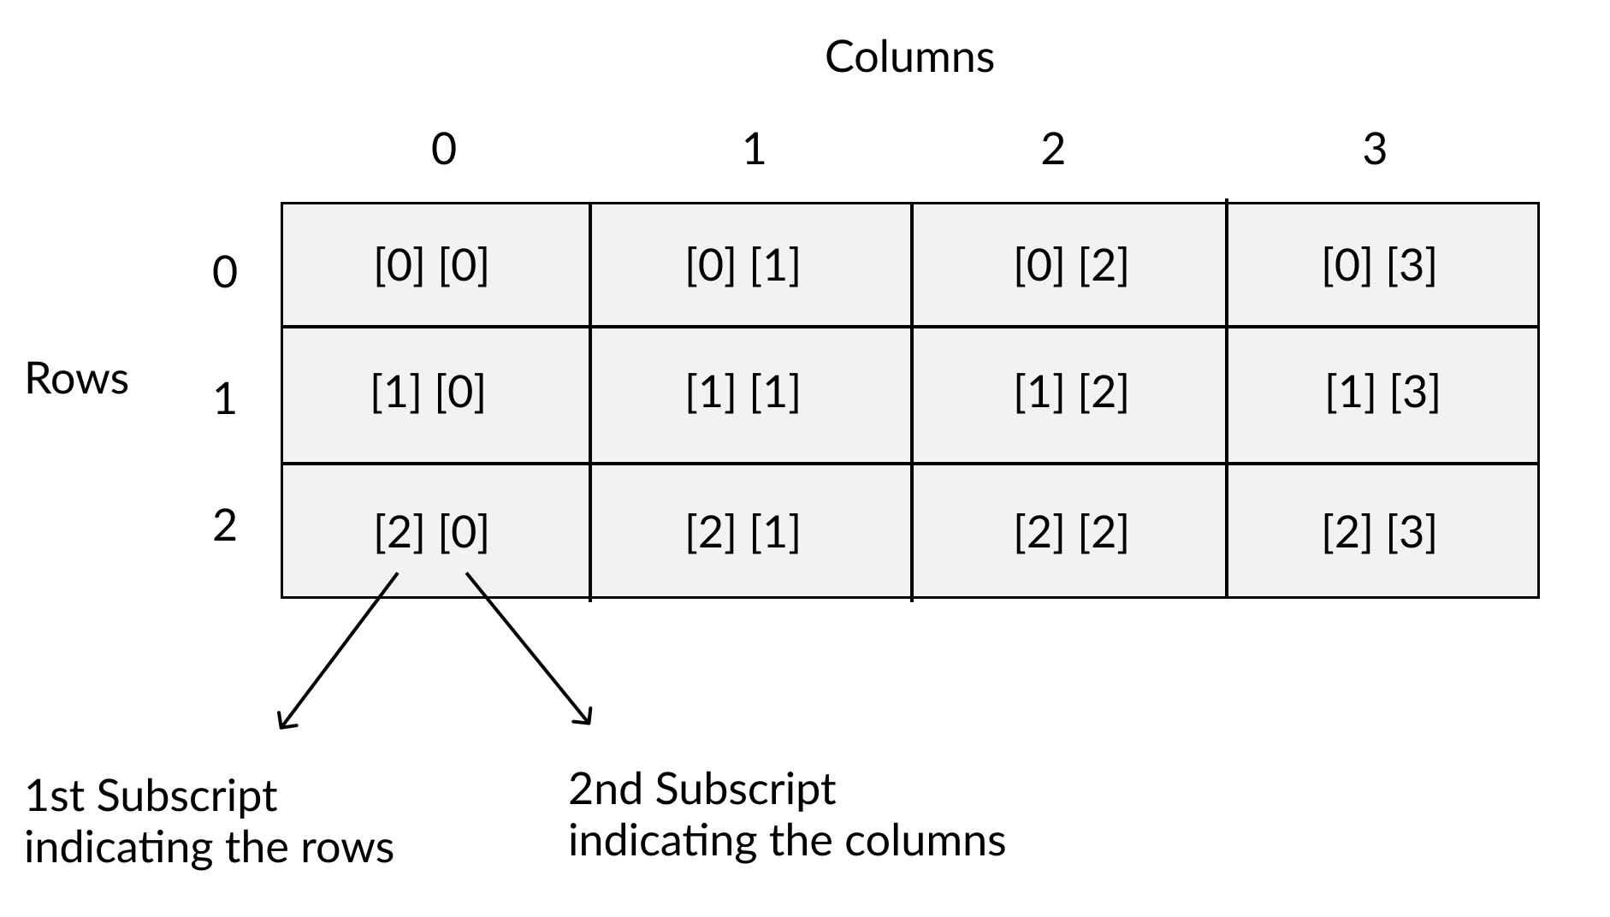
Introduction to Array (CO1)
Two dimensional (2-D) arrays or Matrix arrays:

Slide 58
Introduction to Array (CO1)
There are two main techniques of storing 2D array elements into memory.
1. Row Major ordering
In row major ordering, all the rows of the 2D array are stored into the memory contiguously.

Slide 59
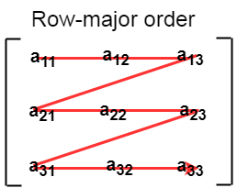
Introduction to Array (CO1)
first, the 1st row of the array is stored into the memory completely, then the 2nd row of the array is stored into the memory completely and so on till the last row.

Slide 60
Introduction to Array (CO1)
Calculate the address of any element in the 2-D array: Row Major Order: assigns successive elements, moving across the rows and then down the next row, to successive memory locations. In simple language, the elements of an array are being stored in a Row-Wise fashion. To find the address of the element using row-major order use the following formula:
Address of A[I][J] = B + W * ((I – LR) * N + (J – LC))
I = Row Subset of an element whose address to be found, J = Column Subset of an element whose address to be found, B = Base address, W = Storage size of one element store in an array(in byte), LR = Lower Limit of row/start row index of the matrix(If not given assume it as zero), LC = Lower Limit of column/start column index of the matrix(If not given assume it as zero), N = Number of column given in the matrix.

Slide 61
Introduction to Array (CO1)
Example: Given an array, arr[1………10][1………15] with base value 100 and the size of each element is 1 Byte in memory. Find the address of arr[8][6] with the help of row-major order?
Solution: Address of A[8][6] = 100 + 1 * ((8 – 1) * 15 + (6 – 1)) = 100 + 1 * ((7) * 15 + (5)) = 100 + 1 * (110) Address of A[I][J] = 210

Slide 62
Introduction to Array (CO1)
2. Column Major ordering
According to the column major ordering, all the columns of the 2D array are stored into the memory contiguously. The memory allocation of the array which is shown in in the above image is given as follows.

Slide 63
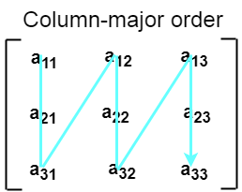
Introduction to Array (CO1)
first, the 1st column of the array is stored into the memory completely, then the 2nd row of the array is stored into the memory completely and so on till the last column of the array.

Slide 64
Introduction to Array (CO1)
Column Major Order: If elements of an array are stored in column-major fashion means moving across the column and then to the next column then it’s in column-major order. To find the address of the element using column-major order uses the following formula:
Address of A[I][J] = B + W * ((J – LC) * M + (I – LR))
I = Row Subset of an element whose address to be found, J = Column Subset of an element whose address to be found, B = Base address, W = Storage size of one element store in any array(in byte), LR = Lower Limit of row/start row index of matrix(If not given assume it as zero), LC = Lower Limit of column/start column index of matrix(If not given assume it as zero), M = Number of rows given in the matrix.

Slide 65
Introduction to Array (CO1)
Example: Given an array arr[1………10][1………15] with base value 100 and the size of each element is 1 Byte in memory find the address of arr[8][6] with the help of column-major order.
Formula: Address of A[I][J] = B + W * ((J – LC) * M + (I – LR)) Address of A[8][6] = 100 + 1 * ((6 – 1) * 10 + (8 – 1)) = 100 + 1 * ((5) * 10 + (7)) = 100 + 1 * (57) Address of A[I][J] = 157

Slide 66
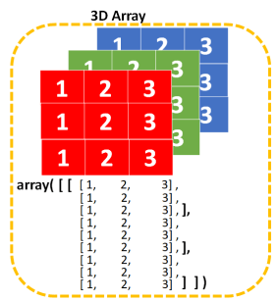
Introduction to Array (CO1)
(b) Three dimensional arrays: In it each element is represented by three subscripts. Thus a three dimensional m x n x l array A contains m*n*l elements. E.g. A [2] [3] [2] has 2*3*2 = 12 elements.

Slide 67
Introduction to Array (CO1)
Applications of Arrays
● Arrays are used to Store List of values
● Arrays are used to Perform Matrix Operations
● Arrays are used to implement Search Algorithms
Linear Search Binary Search
● Arrays are used to implement Sorting Algorithms.
Insertion Sort Bubble Sort
Selection Sort Quick Sort Merge Sort, etc.,
● Arrays are used to implement Data structures.
Stack Using Arrays Queue Using Arrays

Slide 68
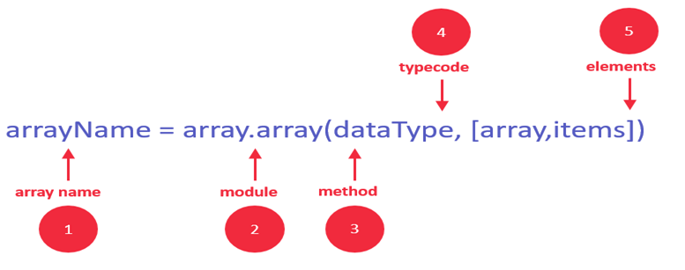
Syntax to Create an Array in Python
Introduction to Array (CO1)
We can declare an array in Python while initializing it using the following syntax.
arrayName = array.array(type code for data type, [array,items])

Slide 69
Introduction to Array (CO1)
Identifier: specify a name like usually, you do for variables
Module: Python has a special module for creating array in Python, called "array" – you must import it before using it
Method: the array module has a method for initializing the array. It takes two arguments, type code, and elements.
Type Code: specify the data type using the type codes available (see list below)
Elements: specify the array elements within the square brackets, for example [130,450,103]

Slide 70
Example
Introduction to Array(CO1)
In Python, we use following syntax to create arrays:
Class array.array(type code[,initializer])
For Example
import array as myarray
abc = myarray.array('d', [2.5, 4.9, 6.7])

Slide 71
Introduction to Array(CO1)
Traverse an Array
We can traverse a Python array by using loops, like this one:
import array
balance = array.array('i', [300,200,100])
for x in balance:
print(x)
Output:
200 300 100

Slide 72
Introduction to Array(CO1)
Access array elements:-
We can access any array item by using its index.
The syntax is
arrayName[indexNum]
For example 1,
import array
balance = array.array('i', [300,200,100]) print(balance[1])
Output:
200

Slide 73
Introduction to Array(CO1)
Example 2:
import array as myarray
abc = myarray.array('d', [2.5, 4.9, 6.7])
print("Array first element is:",abc[0])
print("Array last element is:",abc[-1])
Output:
Array first element is: 2.5
Array last element is: 6.7

Slide 74
Insert element into an array
Introduction to Array(CO1)
Python array insert operation enables you to insert one or more items into an array at the beginning, end, or any given index of the array. This method expects two arguments index and value.
The syntax is
arrayName.insert(index, value)

Slide 75
Example
Introduction to Array(CO1)
In order to insert the new value right "after" index 1, we need to reference index 2 in your insert method, as shown in the below Python array example:
import array balance = array.array('i', [300,200,100]) balance.insert(2, 150) print(balance)
Output:
array('i', [300,200,150,100])

Slide 76
Delete element from an array
Introduction to Array(CO1)
With remove operation, we can delete one item from an array by value. This method accepts only one argument, value. After running this method, the array items are re-arranged, and indices are re-assigned.
The syntax is
arrayName.remove(value)

Slide 77
Example to Delete element from an array
Introduction to Array(CO1)
Let's remove the value of "3" from the array
import array as myarray
first = myarray.array('b', [2, 3, 4])
first.remove(3)
print(first)
Output:
array('b', [2, 4])

Slide 78
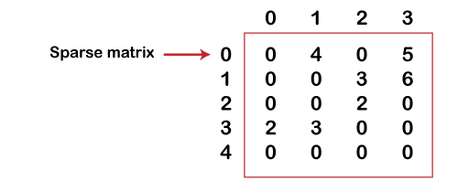
Sparse Matrix
Introduction to Array(CO1)
A matrix can be defined as a two-dimensional array having 'm' columns and 'n' rows representing m*n matrix. Sparse matrices are those matrices that have the majority of their elements equal to zero. In other words, the sparse matrix can be defined as the matrix that has a greater number of zero elements than the non-zero elements.

Slide 79
Introduction to Array(CO1)
Need to use a sparse matrix :-
We can also use the simple matrix to store the elements in the memory; then why do we need to use the sparse matrix. The following are the advantages of using a sparse matrix:
Storage: a sparse matrix that contains lesser non-zero elements than zero so less memory can be used to store elements. It evaluates only the non-zero elements.
Computing time: In the case of searching n sparse matrix, we need to traverse only the non-zero elements rather than traversing all the sparse matrix elements. It saves computing time by logically designing a data structure traversing non-zero elements.

Slide 80
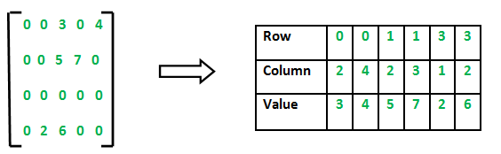
Sparse Matrix Representations
Introduction to Array(CO1)
2D array is used to represent a sparse matrix in which there are three rows named as
Row: Index of row, where non-zero element is located
Column: Index of column, where non-zero element is located
Value: Value of the non zero element located at index – (row,column)

Slide 81
Python Program for Sparse Matrix representation.
Introduction to Array(CO1)
import numpy as np
from scipy.sparse import csr_matrix
# create a 2-D representation of the matrix
A = np.array([[1, 0, 0, 0, 0, 0], [0, 0, 2, 0, 0, 1],\
[0, 0, 0, 2, 0, 0]])
print("Dense matrix representation: \n", A)
# convert to sparse matrix representation
S = csr_matrix(A)
print("Sparse matrix: \n",S)
# convert back to 2-D representation of the matrix
B = S.todense()
print("Dense matrix: \n", B)

Slide 82
Searching Introduction (CO1)
Searching is the technique of selecting specific data from a collection of data based on some condition.
The process of finding an element from a list of elements is known as searching.
Searching is the process of locating given value position in a list of values.

Slide 83
Searching Introduction (CO1)
Unsuccessful Search:
search(40)
Not Found
Successful Search:
search(15)
Found at 3 position
0
1
2
3
4
5
6
25 | 10 | 20 | 15 | 17 | 27 | 10

Slide 84
Types of Searching Techniques (CO1)
linear search:- which simply checks the values in sequence until the desired value is found
binary search:- which requires a sorted input list, and checks for the value in the middle of the list, repeatedly discarding the half of the list which contains values which are definitely either all larger or all smaller than the desired value

Slide 85
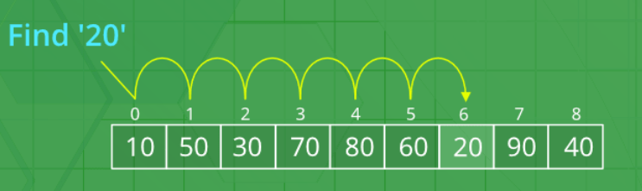
linear search(CO1)
linear search Steps:-
Start from the leftmost element of the list and one by one compare value with each number of the list.
If value matches with an element, return `True`.
else, return `False`

Slide 86
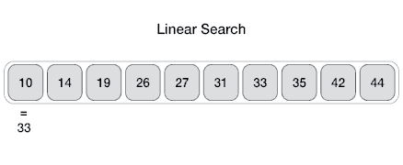
Linear Search (CO1)
Search the array from first to the last position in linear progression.

Slide 87
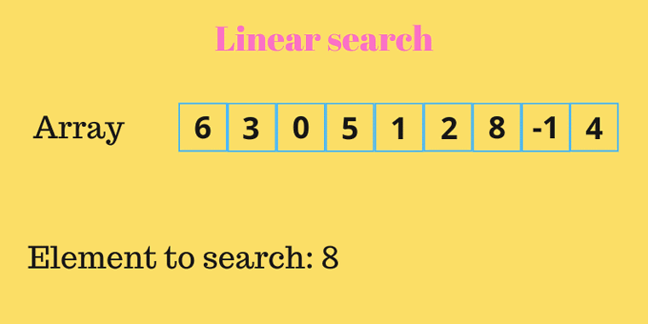
Linear Search (CO1)
Search the array from first to the last position in linear progression.

Slide 88
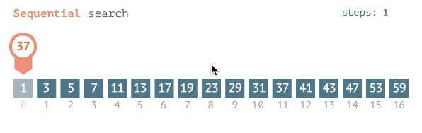
Linear Search (CO1)
Search the array from first to the last position in linear progression.

Slide 89
Python program to perform linear search (CO1)
def search(l, n, x):
for i in range(0, n):
if (l[i] == x):
return i
return -1
l = [2, 3, 4, 10, 40]
x = 10
n = len(l)
result = search(l, n, x)
if(result == -1):
print("Element is not present in list")
else:
print("Element is present at list", result)

Slide 90
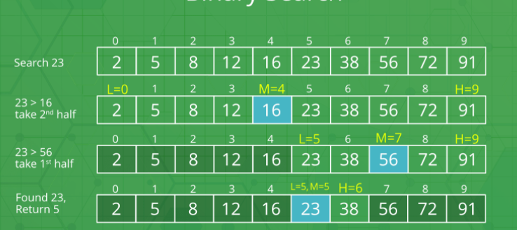
Binary Search(CO1)
Binary search:- which requires a sorted input list, and checks for the value in the middle of the list, repeatedly discarding the half of the list which contains values which are definitely either all larger or all smaller than the desired value

Slide 91
Binary Search(CO1)
Binary search:- searching for a value in a sorted list, the algorithm compares value to the middle element of the list.
If mid is the element we are looking for, we return its index.
If not, we identify which side of mid value is more likely to be on based on whether value is smaller or greater than mid, and discard the other side of the array.
We then recursively or iteratively follow the same steps, choosing a new value for mid, comparing it with value and discarding half of the possible matches in each iteration of the algorithm.

Slide 92
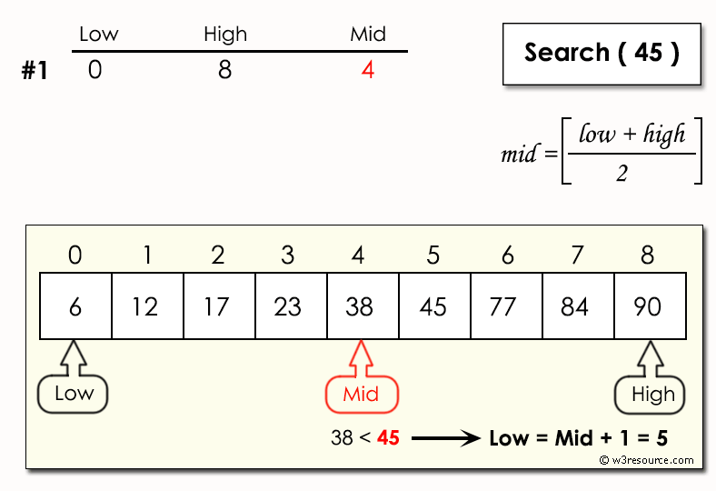
Binary Search(CO1)

Slide 93
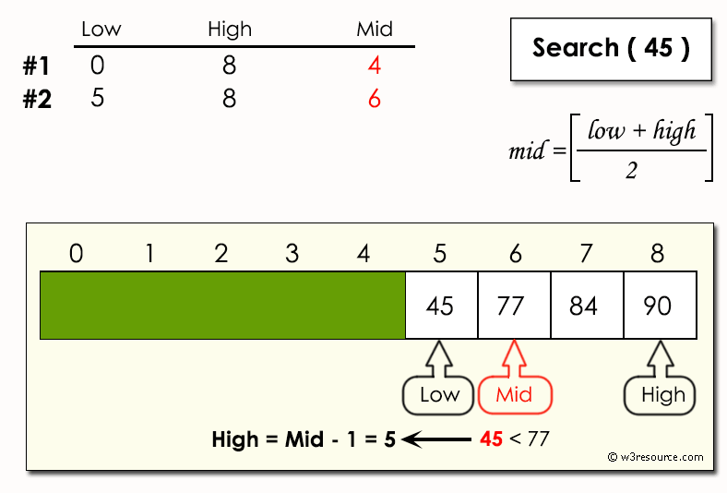
Binary Search(CO1)

Slide 94
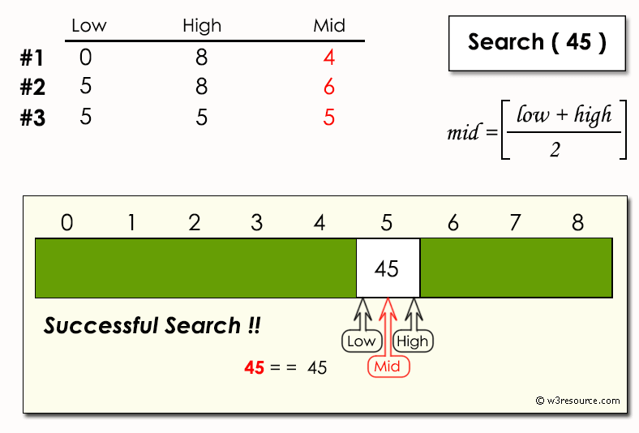
Binary Search(CO1)

Slide 95
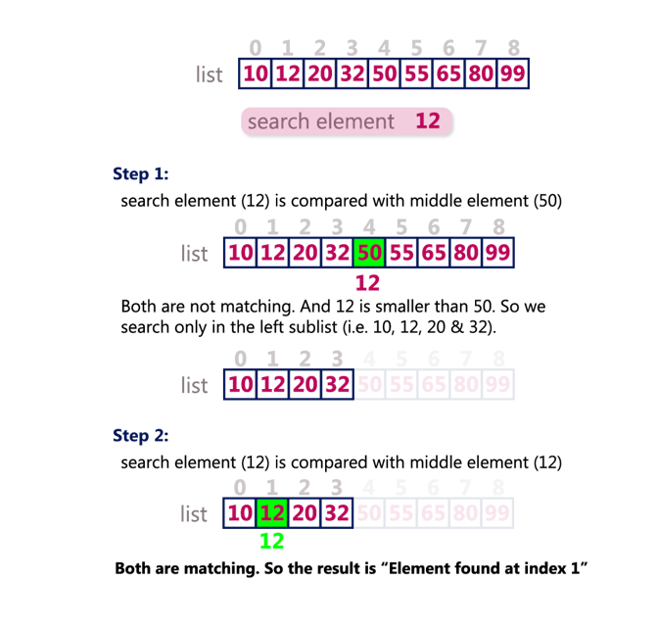
Binary Search(CO1)

Slide 96
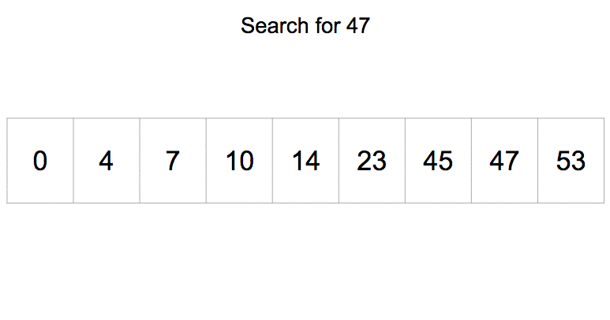
Binary Search(CO1)

Slide 97
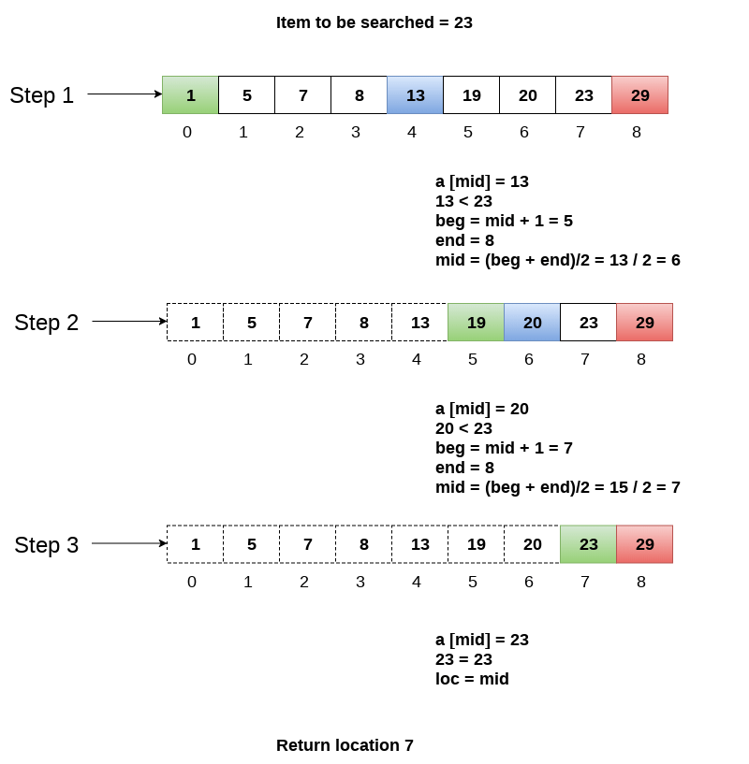
Binary Search(CO1)

Slide 98
Python Program for Binary Search (CO1)
Problem statement − We will be given a sorted list and we need to find an element with the help of a binary search.
Algorithm
Compare x with the middle element.
If x matches with the middle element, we return the mid index.
Else if x is greater than the mid element, then x can only lie in the right (greater) half subarray after the mid element. Then we apply the algorithm again for the right half.
Else if x is smaller, the target x must lie in the left (lower) half. So we apply the algorithm for the left half.

Slide 99
Python program to perform Binary Search (CO1)
def binarysearch(a, val):
first = 0
last = len(a)-1
index = -1
while (first <= last) and (index == -1):
mid = (first+last)//2
if a[mid] == val:
index = mid
else:
if val<a[mid]:
last = mid -1
else:
first = mid +1
return index

Slide 100
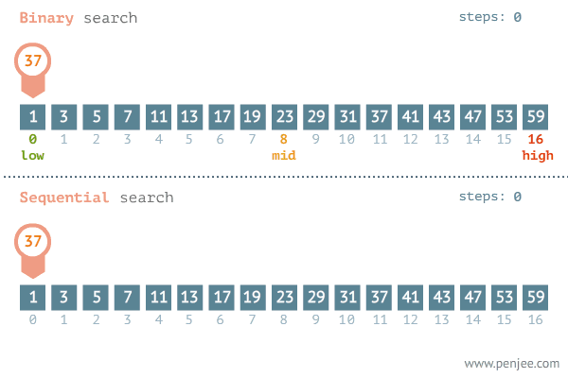
Difference between linear and Binary Search (CO1)

Slide 101
Sorting(CO1)
Sorting is a process of ordering or placing a list of elements from a collection in some kind of order. It is nothing but storage of data in sorted order.
Sorting can be done in ascending and descending order.
It arranges the data in a sequence which makes searching easier.

Slide 102
Sorting(CO1)
Sorting can be performed using several techniques or methods, as follows: 1. Bubble Sort 2. Insertion Sort 3. Selection Sort
4. Radix Sort
5. Merge Sort 6. Quick Sort

Slide 103
Sorting(CO1)
Bubble sort is a simple sorting algorithm. This sorting algorithm is comparison-based algorithm in which each pair of adjacent elements is compared and the elements are swapped if they are not in order.

Slide 104
Sorting(CO1)
Following are the steps involved in bubble sort(for sorting a given array in ascending order):
Starting with the first element(index = 0), compare the current element with the next element of the array.
If the current element is greater than the next element of the array, swap them.
If the current element is less than the next element, move to the next element. Repeat Step 1.

Slide 105
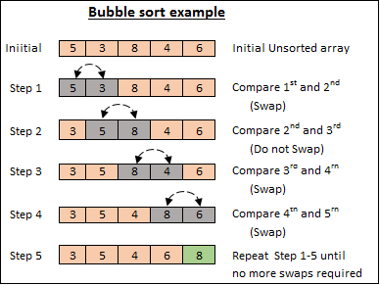
Sorting(CO1)

Slide 106
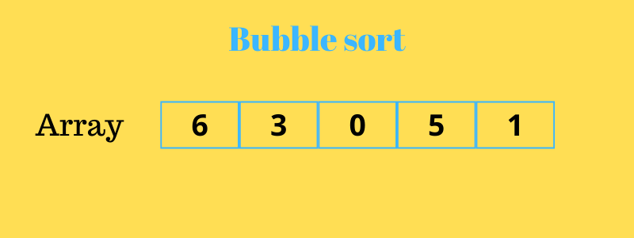
Sorting(CO1)

Slide 107
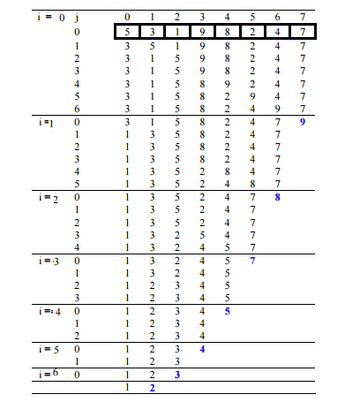
Sorting Using Array(CO1)
Bubble sort Illustration

Slide 108
Sorting Using Array CO1)
Insertion Sort Algorithm
Set a marker for the sorted section, after the first element.
Repeat the following until unsorted section is empty:
Select the first unsorted element
Swap other elements to the right to create the correct position and shift the unsorted elements
Advance the marker to the right one element.

Slide 109
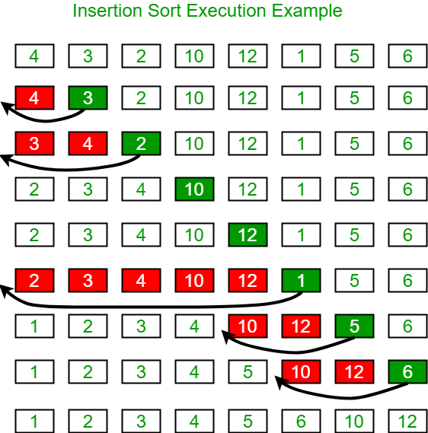
Sorting Using Array CO1)

Slide 110
Sorting Using Array CO1)
Selection sort
The selection sort algorithm sorts an array by repeatedly finding the minimum element (considering ascending order) from unsorted part and putting it at the beginning.
The algorithm maintains two subarrays in a given array.
The subarray which is already sorted.
Remaining subarray which is unsorted.
Select the lowest element in the remaining array
Bring it to the starting position
Change the counter for unsorted array by one.

Slide 111
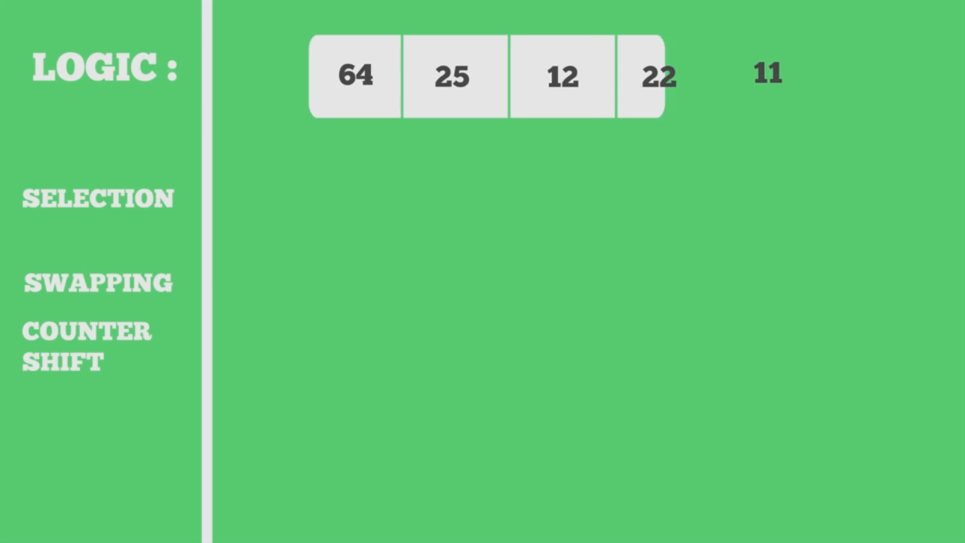
Sorting Using Array CO1)
Selection sort

Slide 112
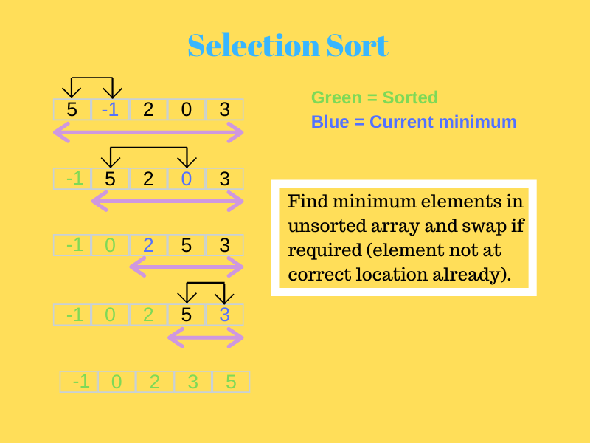
Sorting Using Array CO1)

Slide 113
Selection Sort (CO1)
Steps:-
Step 1) Get the value of n which is the total size of the array
Step 2) Partition the list into sorted and unsorted sections. The sorted section is initially empty while the unsorted section contains the entire list
Step 3) Pick the minimum value from the unpartitioned section and placed it into the sorted section.
Step 4) Repeat the process (n – 1) times until all of the elements in the list have been sorted.

Slide 114
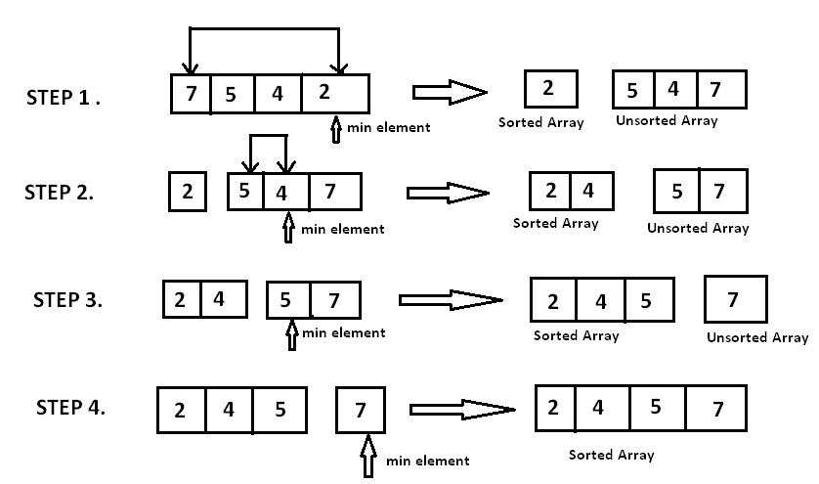
Selection Sort (CO1)

Slide 115
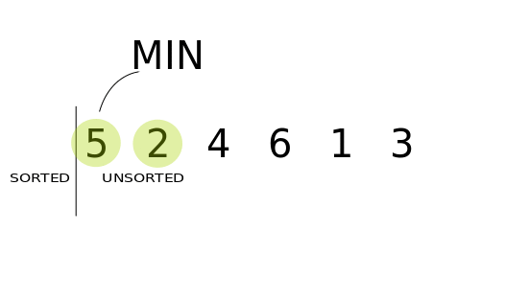
Selection Sort (CO1)

Slide 116
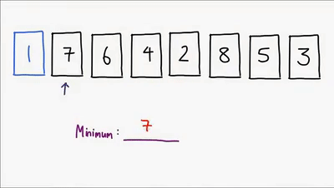
Selection Sort (CO1)

Slide 117
Python Program for Selection Sort (CO1)
def selection_sort(a):
for i in range(0, len(a) - 1):
smallest = i
for j in range(i + 1, len(a)):
if a[j] < a[smallest]:
smallest = j
temp=a[i]
a[i]=a[smallest]
a[smallest]=a[i]
a= [40,90,100,2, 4, 7, 10,105,107]
selection_sort(a)
print('Sorted list: ', end='')
print(a)

Slide 118
Radix sort (CO1)
Radix sort is an integer sorting algorithm that sorts data with integer keys by grouping the keys by individual digits that share the same significant position and value (place value). Radix sort uses counting sort as a subroutine to sort an array of numbers.

Slide 119
Radix sort Algorithm (CO1)
Step 1:Find the largest number in ARR as LARGE
Step 2: [INITIALIZE] SET NOP = Number of digits in LARGE
Step 3: SET PASS =0
Step 4: Repeat Step 5 while PASS <= NOP-1
Step 5: SET I = 0 and INITIALIZE buckets
Step 6:Repeat Steps 7 to 9 while I<n-1< li=""></n-1<>
Step 7: SET DIGIT = digit at PASSth place in A[I]
Step 8: Add A[I] to the bucket numbered DIGIT
Step 9: INCREMENT bucket count for bucket numbered DIGIT [END OF LOOP]
Step 10: Collect the numbers in the bucket [END OF LOOP]
Step 11: END

Slide 120
Radix sort Example (CO1)
A = {10, 2, 901, 803, 1024}
Pass 1: (Sort the list according to the digits at 0's place)
10, 901, 2, 803, 1024.
Pass 2: (Sort the list according to the digits at 10's place)
02, 10, 901, 803, 1024
Pass 3: (Sort the list according to the digits at 100's place)
02, 10, 1024, 803, 901.
Pass 4: (Sort the list according to the digits at 1000's place)
02, 10, 803, 901, 1024

Slide 121
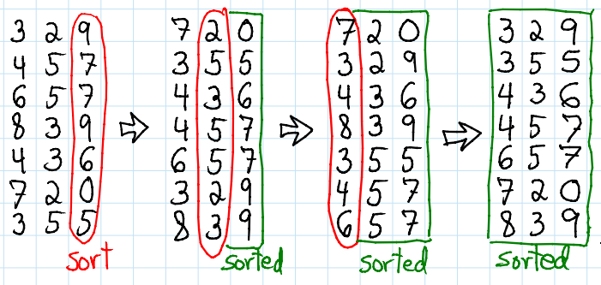
Radix sort Example (CO1)

Slide 122
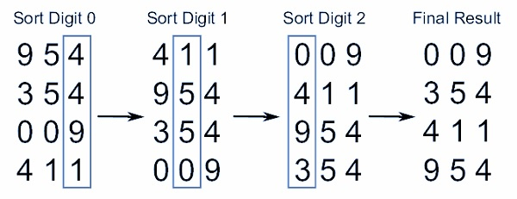
Radix sort Example (CO1)

Slide 123
Merge sort (CO1)
Merge Sort is based on the divide and conquer algorithm where the input array is divided into two halves, then sorted separately and merged back to reach the solution. Merge sort works as follows :
Divide the unsorted list into n sublists, each containing 1 element (a list of 1 element is considered sorted).
Repeatedly merge sublists to produce new sorted sublists until there is only 1 sublist remaining. This will be the sorted list.

Slide 124
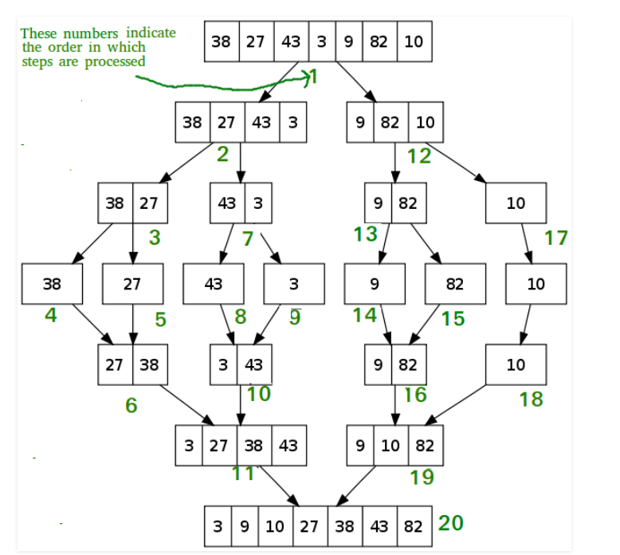
Merge sort Example (CO1)

Slide 125
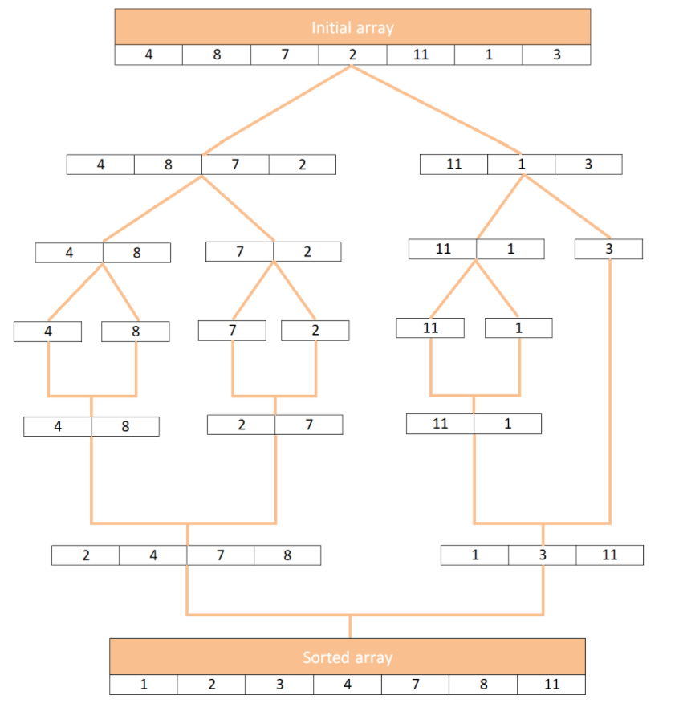
Merge sort Example (CO1)

Slide 126
Merge sort Steps (CO1)
The list is divided into left and right in each recursive call until two adjacent elements are obtained.
Now begins the sorting process. The i and j iterators traverse the two halves in each call. The k iterator traverses the whole lists and makes changes along the way.
If the value at i is smaller than the value at j, left[i] is assigned to the myList[k] slot and i is incremented. If not, then right[j] is chosen.
This way, the values being assigned through k are all sorted.
At the end of this loop, one of the halves may not have been traversed completely. Its values are simply assigned to the remaining slots in the list.

Slide 127
Quick sort (CO1)
Quicksort is a sorting algorithm based on the divide and conquer approach where
An array is divided into subarrays by selecting a pivot element (element selected from the array). While dividing the array, the pivot element should be positioned in such a way that elements less than pivot are kept on the left side and elements greater than pivot are on the right side of the pivot.
The left and right subarrays are also divided using the same approach. This process continues until each subarray contains a single element.
At this point, elements are already sorted. Finally, elements are combined to form a sorted array.

Slide 128
Quick sort Algorithm (CO1)
In Quick sort algorithm, partitioning of the list is performed using following steps...
Step 1 - Consider the first element of the list as pivot (i.e., Element at first position in the list).
Step 2 - Define two variables i and j. Set i and j to first and last elements of the list respectively.
Step 3 - Increment i until list[i] > pivot then stop.
Step 4 - Decrement j until list[j] < pivot then stop.
Step 5 - If i < j then exchange list[i] and list[j].
Step 6 - Repeat steps 3,4 & 5 until i > j.
Step 7 - Exchange the pivot element with list[j] element.

Slide 129
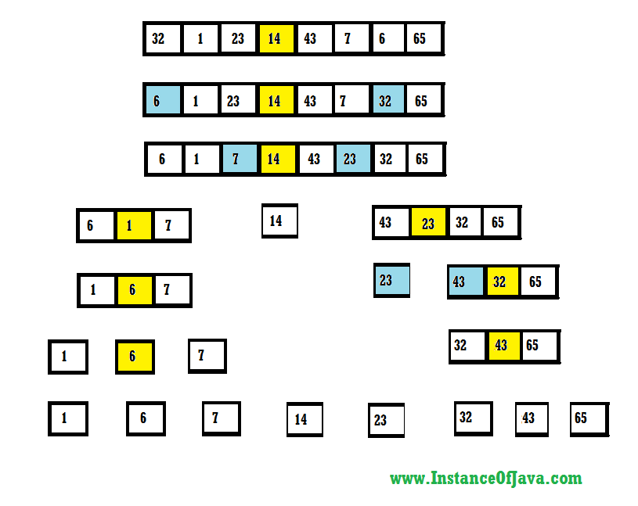
Quick sort Example (CO1)

Slide 130
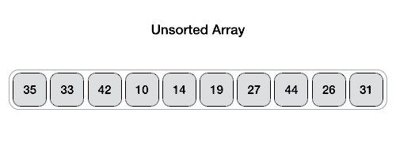
Quick sort Example(CO1)

Slide 131
Hashing(CO1)
Hashing is a technique or process of mapping keys, values into the hash table by using a hash function. It is done for faster access to elements. The efficiency of mapping depends on the efficiency of the hash function used.
Hashing is one of the searching techniques that uses a constant time.
Hash Function is a function which applied to the key, produced an integer which can be used as an address in a hash table.
The Hash table data structure stores elements in key-value pairs where
Key- unique integer that is used for indexing the values
Value - data that are associated with keys.

Slide 132
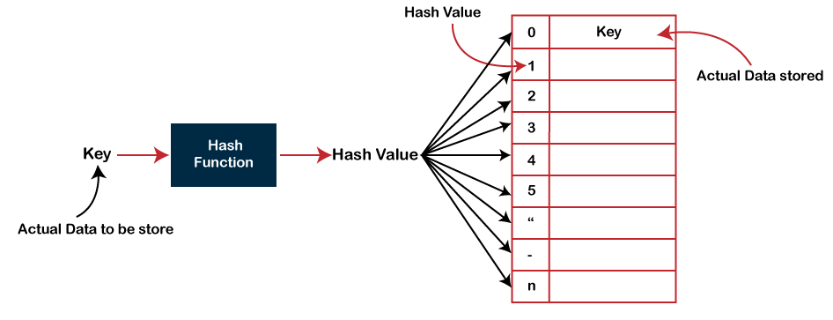
Hashing(CO1)

Slide 133
Hash Table(CO1)
A Hash table is a data structure that stores some information, and the information has basically two main components, i.e., key and value. The hash table can be implemented with the help of an associative array. The efficiency of mapping depends upon the efficiency of the hash function used for mapping.

Slide 134
Hash Function
Hashing
Hash function is a function that maps any big number or string to a small integer value.
Hash function takes the data item as an input and returns a small integer value as an output.
The small integer value is called as a hash value.
Hash value of the data item is then used as an index for storing it into the hash table.
Hash function is a function that maps any big number or string to a small integer value. Hash function takes the data item as an input and returns a small integer value as an output. The small integer value is called as a hash value. Hash value of the data item is then used as an index for storing it into the hash table.

Slide 135
Hash Functions
Hashing
Types of Hash Functions-
There are various types of hash functions available such as-
Mid Square Hash Function
Division Hash Function
Folding Hash Function

Slide 136
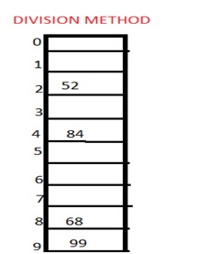
Hashing
1. Division method
In this the hash function is dependent upon the remainder of a division. For example:-if the record 52,68,99,84 is to be placed in a hash table and let us take the table size is 10.
Then:
h(key)=record% table size.
2=52%10
8=68%10
9=99%10
4=84%10

Slide 137
Hashing
2. Mid square method
In this method firstly key is squared and then mid part of the result is taken as the index. For example: consider that if we want to place a record of 3101 and the size of table is 1000. So 3101*3101=9616201 i.e. h (3101) = 162 (middle 3 digit)

Slide 138
Hashing
3. Digit folding method
In this method the key is divided into separate parts and by using some simple operations these parts are combined to produce a hash key. For example: consider a record of 12465512 then it will be divided into parts i.e. 124, 655, 12. After dividing the parts combine these parts by adding it.
H(key)=124+655+12
=791

Slide 139
Hashing
Collision
It is a situation in which the hash function returns the same hash key for more than one record, it is called as collision. Sometimes when we are going to resolve the collision it may lead to a overflow condition and this overflow and collision condition makes the poor hash function.
The following are the collision techniques:
Open Hashing: It is also known as closed addressing.
Closed Hashing: It is also known as open addressing.

Slide 140
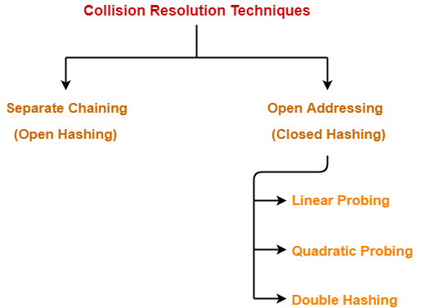
Hashing
Collision resolution technique
If there is a problem of collision occurs then it can be handled by apply some technique. These techniques are called as collision resolution techniques.

Slide 141
Separate Chaining
Hashing
In this technique, a linked list is created from the slot in which collision has occurred, after which the new key is inserted into the linked list. This linked list of slots looks like a chain, so it is called separate chaining. It is used more when we do not know how many keys to insert or delete.
Time complexity
Its worst-case complexity for searching is o(n).
Its worst-case complexity for deletion is o(n).

Slide 142
Example
Hashing
Keys: 0, 1, 4, 9, 16, 25, 36, 49, 64, 81
hash(key) = key % 10.
0
0
1
2
81
1
3
4
64
4
5
25
6
36
16
7
8
9
49
9

Slide 143
Separate Chaining
Hashing
Advantages of separate chaining
It is easy to implement.
The hash table never fills full, so we can add more elements to the chain.
It is less sensitive to the function of the hashing.
Disadvantages of separate chaining
In this, cache performance of chaining is not good.
The memory wastage is too much in this method.
It requires more space for element links.

Slide 144
Collision Resolution with Open Addressing
Hashing
Open addressing is collision-resolution method that is used to control the collision in the hashing table. There is no key stored outside of the hash table. Therefore, the size of the hash table is always greater than or equal to the number of keys. It is also called closed hashing.
The following techniques are used in open addressing:
Linear probing
Quadratic probing
Double hashing

Slide 145
Linear Probing
Hashing
In this, when the collision occurs, we perform a linear probe for the next slot, and this probing is performed until an empty slot is found. In linear probing, the worst time to search for an element is O(table size).
h´(𝑥) = 𝑥 𝑚𝑜𝑑 𝑚
ℎ(𝑥, 𝑖) = (ℎ´(𝑥) + 𝑖)𝑚𝑜𝑑 𝑚

Slide 146
Linear Probing Steps
Hashing
1. Calculate the hash key. key = data % size;
If hashTable[key] is empty, store the value directly. hashTable[key] = data.
2. If the hash index already has some value, check for next index.
key = (key+1) % size;
If the next index is available hashTable[key], store the value. Otherwise try for next index.
3.Do the above process till we find the space.

Slide 147
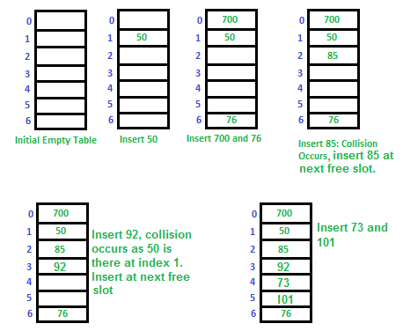
Let us consider a simple hash function as “key mod 7” and a sequence of keys as 50, 700, 76, 85, 92, 73, 101.
Hashing

Slide 148

Linear Probing Example
Hashing

Slide 149
Linear Probing
Hashing
Advantages of linear probing
The linear probing gives the best performance of the cache .
It can be easily calculated.
Disadvantages of linear probing
The main problem is clustering.
It takes too much time to find an empty slot.

Slide 150
Quadratic Probing
Hashing
In quadratic probing,
When collision occurs, we probe for i²‘th bucket in i^{th} iteration.
We keep probing until an empty bucket is found.
h´ = (𝑥) = 𝑥 𝑚𝑜𝑑 𝑚
ℎ(𝑥, 𝑖) = (ℎ´(𝑥) + 𝑖²)𝑚𝑜𝑑 𝑚

Slide 151
Steps for Quadratic Probing
Hashing
Let hash(x) be the slot index computed using the hash function.
If the slot hash(x) % S is full, then we try (hash(x) + 1*1) % S
If (hash(x) + 1*1) % S is also full, then we try (hash(x) + 2*2) % S.
If (hash(x) + 2*2) % S is also full, then we try (hash(x) + 3*3) % S.
This process is repeated for all the values of i until an empty slot is found.

Slide 152

Quadratic Probing Example
Hashing
we have a list of size 20 (m = 20). We want to put some elements in linear probing fashion. The elements are {96, 48, 63, 29, 87, 77, 48, 65, 69, 94, 61}

Slide 153
Double Hashing
Hashing
In double hashing,
We use another hash function hash2(x) and look for i * hash2(x) bucket in i^{th} iteration.
It requires more computation time as two hash functions need to be computed.
Double hashing can be done using : (hash1(key) + i * hash2(key)) % TABLE_SIZE Here hash1() and hash2() are hash functions and TABLE_SIZE is size of hash table.(We repeat by increasing i when collision occurs)

Slide 154
Double Hashing Example
Hashing
Example:
Load the keys 18, 26, 35, 9, 64, 47, 96, 36, and 70 in this order, in an empty hash table of size 13 (a) using double hashing with the first hash function:
h(key) = key % 13 and
the second hash function:
hp (key) = 1 + key % 12

Slide 155

Double Hashing
Hashing

Slide 156
Comparison of Open Addressing Techniques-
Hashing
 | Linear Probing | Quadratic Probing | Double Hashing
Primary Clustering | Yes | No | No
Secondary Clustering | Yes | Yes | No
Number of Probe Sequence (m = size of table) | m | m | m²
Cache performance | Best | Lies between the two | Poor

Slide 157
Faculty Video Links, Youtube & NPTEL Video Links and Online Courses Details
Youtube/other Video Links
https://www.youtube.com/watch?v=zWg7U0OEAoE&list=PLBF3763AF2E1C572F&index=1
https://www.youtube.com/watch?v=aGjL7YXI31Q&list=PLEbnTDJUr_IeHYw_sfBOJ6gk5pie0yP-0
https://www.youtube.com/watch?v=FEnwM-iDb2g&list=PLEbnTDJUr_IeHYw_sfBOJ6gk5pie0yP-0&index=2
https://www.youtube.com/watch?v=HEjmH9wKiMo&list=PLEbnTDJUr_IeHYw_sfBOJ6gk5pie0yP-0&index=6
https://www.youtube.com/watch?v=sr_bR1WwcLY
https://www.youtube.com/watch?v=puMz5Jt96sg
https://www.youtube.com/watch?v=d_XvFOkQz5k&list=PLhb7SOmGNUc5AZurO-im4t_RDr-ymjz0d&index=1
https://www.youtube.com/watch?v=KELqVT7hjeE&list=PLhb7SOmGNUc5AZurO-im4t_RDr-ymjz0d&index=2
https://www.youtube.com/watch?v=CZYR2v8rYLA&list=PLhb7SOmGNUc5AZurO-im4t_RDr-ymjz0d&index=3
https://www.youtube.com/watch?v=-lY4_THb2wM&list=PLhb7SOmGNUc5AZurO-im4t_RDr-ymjz0d&index=4

Slide 158
Daily Quiz
What are the advantages of arrays? a) Objects of mixed data types can be stored b) Elements in an array cannot be sorted c) Index of first element of an array is 1 d) Easier to store elements of same data type

Slide 159
Daily Quiz
2. What are the disadvantages of arrays? a) Data structure like queue or stack cannot be implemented b) There are chances of wastage of memory space if elements inserted in an array are lesser than the allocated size c) Index value of an array can be negative d) Elements are sequentially accessed

Slide 160
Daily Quiz
3. In general, the index of the first element in an array is __________ a) 0 b) -1 c) 2 d) 1

Slide 161
Daily Quiz
4. If the number of records to be sorted is small, then …… sorting can be efficient. A. Merge B. Insertion C. Selection D. Bubble

Slide 162
Daily Quiz
5.Which of the following is not a limitation of binary search algorithm? A. must use a sorted array B. requirement of sorted array is expensive when a lot of insertion and deletions are needed C. there must be a mechanism to access middle element directly D. binary search algorithm is not efficient when the data elements more than 1500.

Slide 163
Daily Quiz
6. What is a hash table? a) A structure that maps values to keys b) A structure that maps keys to values c) A structure used for storage d) A structure used to implement stack and queue

Slide 164
Daily Quiz
7. If several elements are competing for the same bucket in the hash table, what is it called? a) Diffusion b) Replication c) Collision d) Duplication

Slide 165
Daily Quiz
8. What is a hash function? a) A function has allocated memory to keys b) A function that computes the location of the key in the array c) A function that creates an array d) A function that computes the location of the values in the array

Slide 166
Daily Quiz
9. ………. is putting an element in the appropriate place in a sorted list yields a larger sorted order list. A. Insertion B. Extraction C. Selection D. Distribution

Slide 167
Daily Quiz
10. Which of the following sorting algorithm is of divide and conquer type? A. Bubble sort B. Insertion sort C. Merge sort D. Selection sort

Slide 168
MCQ s
In ........, search start at the beginning of the list and check every element in the list.
Binary search
Hash Search
Linear search
Binary Tree search.
2. To represent hierarchical relationship between elements, which data structure is suitable?
Graph
Tree
Dequeue
Priority Queue
3. Which of the following data structure is linear type?
Stack
Graph
Trees
Binary tree
4.Which of the following data structure can’t store the nonhomogeneous data elements?
Arrays
Stacks
Records
None of the above

Slide 169
MCQ s
5. Two main measures for the efficiency of an algorithm are
Processor and memory
Complexity and capacity
Time and space
Data and space
6. The Worst case occur in linear search algorithm when
Item is somewhere in the middle of the array
Item is not in the array at all
Item is the last element in the array
Item is the last element in the array or is not there at all
7. The complexity of Binary search algorithm is
O(n)
O(log₂n )
O(n²)
O(n log₂ n)
8. The complexity of linear search algorithm is
O(n)
O(log₂n )
O(n²)
O(n log₂ n)

Slide 170
MCQ s
9. Arrays are best data structures
for relatively permanent collections of data
for the size of the structure and the data in the structure are constantly changing
for both of above situation
for none of above situation
10. Linked lists are best suited
for relatively permanent collections of data
for the size of the structure and the data in the structure are constantly changing
for both of above situation
for none of above situation

Slide 171
Expected Questions for University Exam
Q1. Distinguish between linear and nonlinear data structures.
Q2. Write a program to insert a new element in the given unsorted array at kth
position.
Q3. Define data structure with example.
Q4 . How 2-D arrays are represented in memory? Also obtain the formula for calculating the address of any element stored in 2-D array in case of column-major order.
Q5 Explain Binary search and write a program to perform binary search in python .
Q6 Write the difference between link list and array.

Slide 172
Old Question Papers
https://drive.google.com/open?id=15fAkaWQ5ccZRZPzwlP4PBh1LxcPp4VAd

Slide 173
Summary
We consider two fundamental data types for storing collections of objects: the stack and the queue.
We implement each using either a singly-linked list or a resizing array.
We introduce two advanced Java features—generics and iterators—that simplify client code.
Finally, we consider various applications of stacks and queues ranging from parsing arithmetic expressions to simulating queueing systems.

Slide 174
References
[1] Aaron M. Tenenbaum, Yedidyah Langsam and Moshe J. Augenstein, “Data Structures Using C and C++”, PHI Learning Private Limited, Delhi India
[2] Horowitz and Sahani, “Fundamentals of Data Structures”, Galgotia Publications Pvt Ltd Delhi India.
[3] Lipschutz, “Data Structures” Schaum’s Outline Series, Tata McGraw-hill Education (India) Pvt. Ltd.
[4] Thareja, “Data Structure Using C” Oxford Higher Education.
[5] AK Sharma, “Data Structure Using C”, Pearson Education India.

Slide 175
Thank you

